Slide 1
The EUROPEAN UNION
Constitutional Nature; A Federation of States?

Slide 2
The EUROPEAN UNION
How does the EU operate?
The European Tradition
The EU in light of the American tradition
The sui generis theory
The international law theory
The three constitutional denials
Democratic deficit?
Conclusion

Slide 3
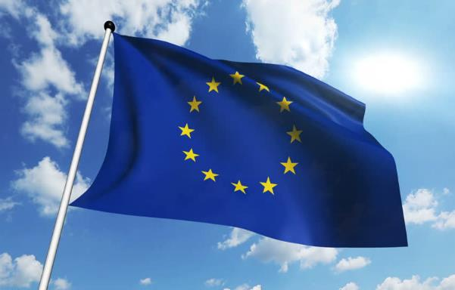
How does the eu operate?
International law historically operates on a voluntary and unenforceable basis; protecting the historical concept of absolute sovereignty.
In accordance with the concept, no authority can be held to be above an individual state.
Is the EU a Confederation of States or a Federation of States?
The European Union itself holds the belief that its constitutional framework is sui generis; incomparable to any other union due to its unique nature.

Slide 4
Federalism as international law
The American Tradition
The 1787 Constitution of the USA established federalism.
Sought to consolidate the 1777 Constitution.
Confederation of States v Federalism; the sovereignty battle.
What is federalism?
Federalism is a system of government in which entities such as states or provinces share power with a national government.
Madison; 3 Dimensions of Federalism
The Foundational Federalism: Origin and character of the constitution.
The Institutional Federalism; Composition of government institutions
The Functional Federalism; Scope and nature of federal powers.

Slide 5
The Mixed federation
The 1787 Constitution was an International Act; needed to be ratified by unanimous assent of the States. (voluntary act)
House of Representatives; The States
The Senate; International Organ (Federal Government)
Central government had both national & international powers; hence a mixed government.
Each state gave up some sovereignty whilst the national government remained incomplete;
Concept of dualism created:
Dual government, dual sovereignty, dual citizenship
“The sovereignty of the United States is shared between the Union and the States whilst in France it is undivided and compact.” Tocqueville (1954)

Slide 6
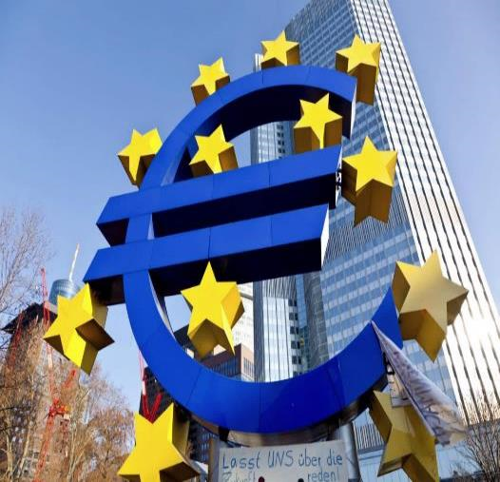
The European tradition
History of Absolute Sovereignty
According to Dicey, sovereignty of a state was indivisible and absolute.
The European Union of States could only be a confederation or a federal state.
^ International Act; following voluntary nature of ordinary international law.
Confederation of States?
Member states could only be the authors of the Unions suggestions (Jellinek)
Federal State?
Higher, sovereign authority with unifying power.
Member states lose all sovereignty.

Slide 7
Criticisms of the European tradition
What is a federal union of states?
“A federal union was one that was a permanent union based on a voluntary agreement whose object is the political preservation of its members.” Schmitt
The Federation is characterised by dualism;
“In each federal body, two kinds of political bodies co-exist: the existence of the whole federation and the individual existence of each federal member.” Schutze
Kelsen (1920)
Was loyal to the concept of indivisible sovereignty.
Schmitt (2003)
Agreed with Kelsen regarding there being no difference between a confederation and a federal state.
Believed there was no difference between a confederation of states or a federal state.
The concept that treaties and constitutions were mutually exclusive was wrong.
The concept of sovereignty was a psychological one of social perception.
Didn’t agree with the tautogical nature of federal Europe.
Both two species of federalism.
Did not focus enough on defining what each species was.

Slide 8
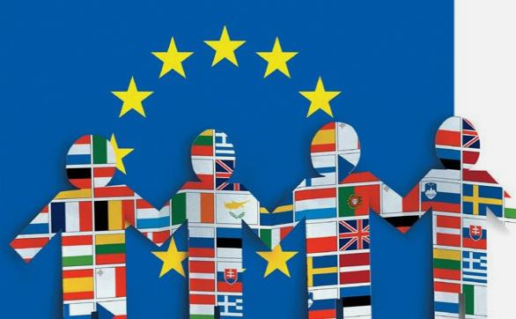
THE EU IN LIGHT OF THE AMERICAN TRADITION
Foundational dimension;
The European Union of States was formed by international treaties, they were ratified by the national legislators, (not the people.)
The Treaties were elevated to a constitutional status due to societies perception of it.
Non-contractual nature of EU law in Commission v Luxembourg & Belgium [1963]
Article 9 of the TEU established European citizenship; members are citizens of two separate political orders.
Les Verts [1986] The EU Treaties despite being formed as an International Agreement constitutes the constitutional charter of a Union based on article of law. (para. 23)
The EU is characterised by dualism; political dualist position, federal citizenship and national citizenship, as well as a balanced approach to legislation making.

Slide 9
THE EU IN LIGHT OF THE AMERICAN TRADITION (cont.)
The principle law makers of the European Union is the Parliament and the Council. The composition of the Parliament has changed over time to become a body of fully elected individuals, voted for my citizens of Europe making the law making process more national in nature.
The people of the EU are represented by the members of parliament and the majority voting procedure. (Art 231 TFEU) The international organ of the EU is the Council, which is formulated from national ministers representing their own governments. (Art 16(2) TEU)
To limit the effect on the sovereignty of the member states by the Council decisions, unanimous or qualified majority voting occurs. The Council operates as a middle ground between national/international interests providing a federal balance.
Institutional Dimension; Dual Basis of Democratic Legitimacy

Slide 10
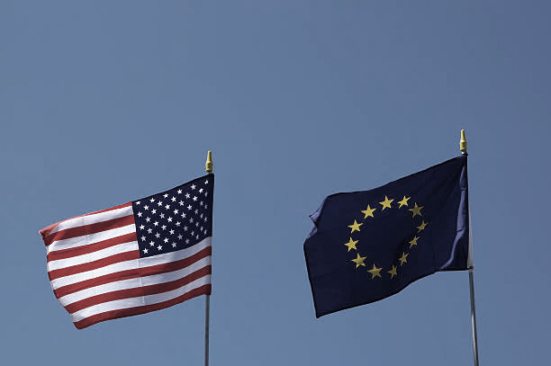
THE EU IN LIGHT OF THE AMERICAN TRADITION (cont.)
Functional dimension
Europe has significant legislative powers however the scope of the EU government is limited by its incomplete nature.
The European Court of Justice has extended the scope of EU legislation by introducing direct effect. (Van Gend en Loos)
This limits the requirement of member states having to incorporate directives.
Decentralised application of European law through supremacy; All institutions of a member state must disapply conflicting national law.
European law largely follows the logic of state responsibility in public international law, (Kadelbach 2002) due to lack of enforcement options.

Slide 11
THE EU IN LIGHT OF THE EUROPEAN TRADITION
Supranationalism;
Refers to a large amount of power given to an authority which in theory is placed higher than the state. (The EU)
Intergovernmentalism;
Focuses on the importance of member states in the process of creating EU-wide regulations.
Sui Generis Theory
Stems from the concept that the EU is a completely unique union and hence not comparable to a confederation or a federal state.

Slide 12
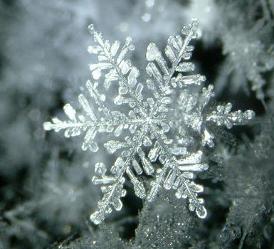
THE SUI GENERIS THEORY
Europe is incomparable as it cannot be fitted into the traditional categories of international or constitutional law.
Sui Generis theory, in determining the European Union to be incomparable raises a number of issues;
Fails to analyse the Union
Only views the Union in negative terms.
It provides no means to measure the EU evolution.
Is historically unfounded as all previous Union of states lay between both international and national law.
Based on undivided sovereignty which creates problems when examining the dual nature that characterises the EU.
Europe's statist tradition insists that the EU is international in nature and not unique.

Slide 13
THE INTERNATIONAL LAW THEORY
The Maastricht Decision
The German Supreme Court contested that Europe’s social structure would set limits on the constitutional structure of the EU.
No equivalent to European national peoples so there would be a legal limit to integration.
“Union of States as an ever closer union of the peoples of Europe (organised as States,) and not a State based on the people of one European Union.”
All legal authority of the EU derives from the Member States.
EU laws can only have effect by virtue of the sovereign instruction that the law is applied.
If an EU law goes beyond the national scope it will have no effect.
The ultimate decider of the legitimacy of an EU law is sovereign supreme courts.
European law is international law.

Slide 14
THE THREE CONSTITUTIONAL DENIALS
The constitutional conflict over the Maastricht Treaty brought to light the statist
tradition of the European Union.
No People
No Constitution
No Constitutionalism
Citizens are needed to make a constitution and a constitution is needed for the establishment of constitutionalism.
Rise of nationalism; people’s identified via their nation.
National peoples can be viewed as mutually exclusive.
European citizenship separate from national citizenship.
“It is inherent in a constitution in the full sense of the term that it goes back to an act take by or at least attributed to the people, in which they attribute political capacity to themselves.” (Zweig)
Argument is that there is no source for Primary Union law
European Union is given its constitution through third parties.
Europes constitutional architecture has never been validated by a process of constitutional adoption by a European constitutional demos. (Weiler)
With no constitutional demos; there can be no European constitutionalism.

Slide 15
IS THE DEMOCRATIC DEFICIT A REAL PROBLEM?
Democratic deficit exhibited in the decision making process of the Union?
All legislative decisions are theoretically legitimised by one source the democratic nature of this is questionable.
Federal polity; 2 arenas of democracy.
Federation of Europe?
The European Union is based on a dual structure of legitimacy;
The totality of the Union’s citizens
The peoples of the European Union
Elections provide two lines of democratic legitimacy.
Duplex regimen=dual democracy.

Slide 16
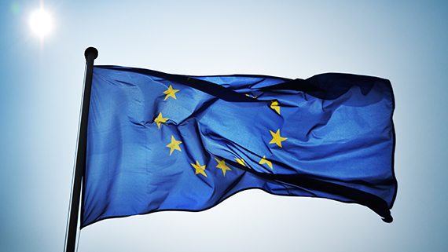
CONCLUSION
The European Union has a mixed structure; it exists in a federal middle ground.
The Sui Generis theory that populated EU law initially is not an accurate perspective from which to examine the purpose of the EU from.
The European Union is both an international and national being.
It is a federation of States and the uniqueness of this concept is partly the cause for the success of the European Union.
The Union enjoys real powers stemming from a limitation on sovereignty (transfer of powers).

